Slide 1
Mask-it or Casket
By: Megan Zimerman, Ivan Pinedo, Jamison Unruh & Karl Konzi

Slide 2
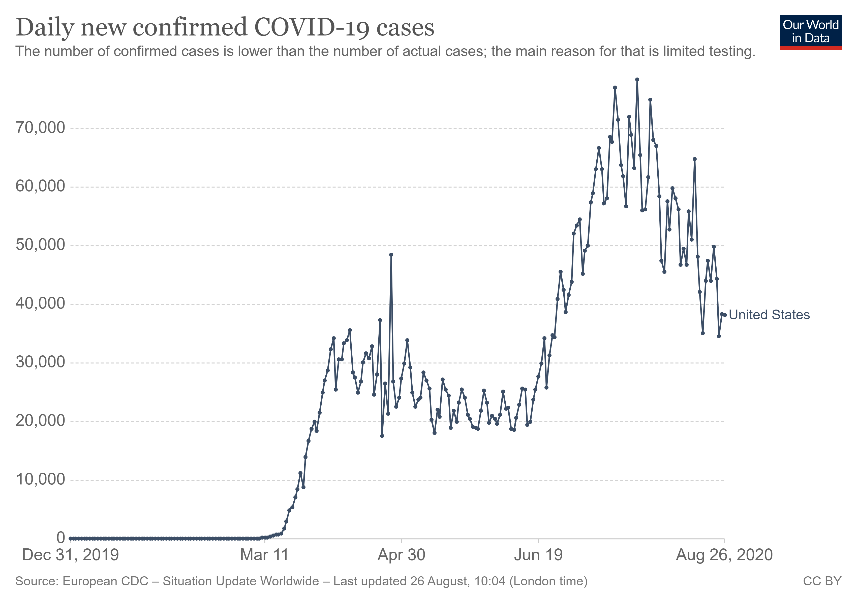
Hypothesis
COVID-19 is a highly transmissible virus that quickly spread throughout the US in early 2020. We believe the lack of a nationally coordinated effort to contain the virus lead to a sharp rise in overall infections as states mapped out their own plans and timelines.

Slide 3
Questions Asked
Did lockdown dates and phased re-openings have an impact on the spread of the virus?
Was there a negative impact to states that took a delayed approach to lockdown compared to states that chose to lockdown early?
Did the summer months lead to a spike in infection rates?
Did state-wide mask mandates have an impact on curbing the spread of the virus?

Slide 4
Why?
We were interested in proving that the lack of coordination in the nation, specifically when it comes to lockdowns, re-openings, and mask mandates, has caused more cases in this country than it should have.
By comparing states in geographically diverse locations we want to show how important each of these were.

Slide 5
Data Needed
To prove our hypothesis we needed data on all 50 states from March till August!
We needed to know which day each state began its lockdown, when they re-opened, or when mask mandates began
We needed data that showed all positive cases in each state, all the hospitalizations, and deaths

Slide 6
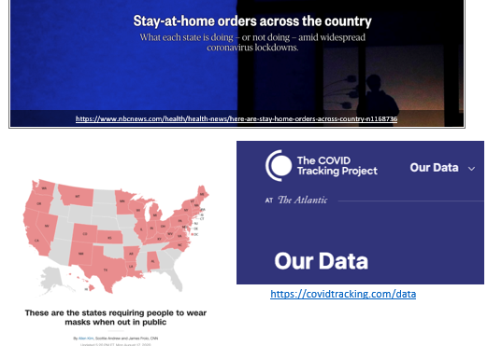
Data Found!

Slide 7
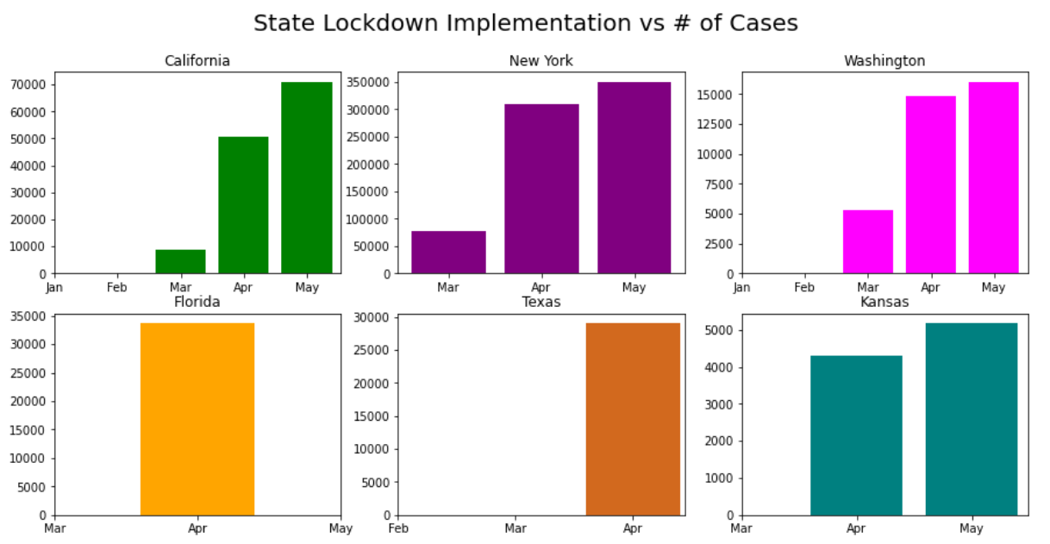
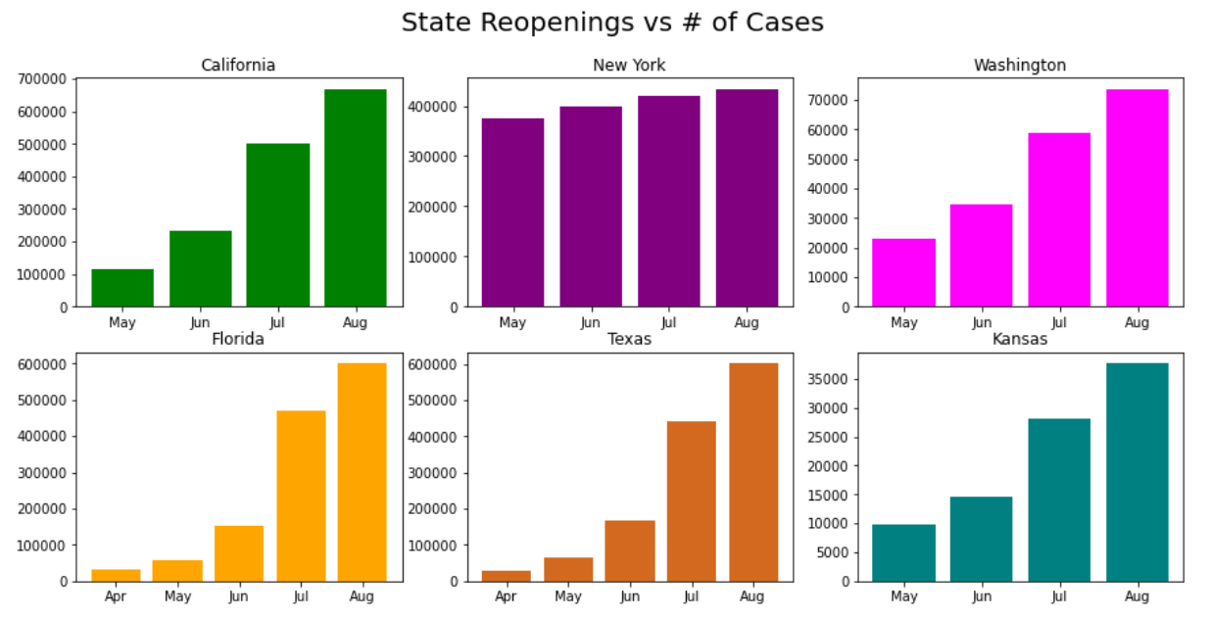
Key Findings
The data shows that most states in this data set reopened too quickly or did not stay locked down long enough to contain the spread of the virus.
Whether a state locked down quickly or late did not effect the spread of the virus so much as the reopening plans of each state.

Slide 8
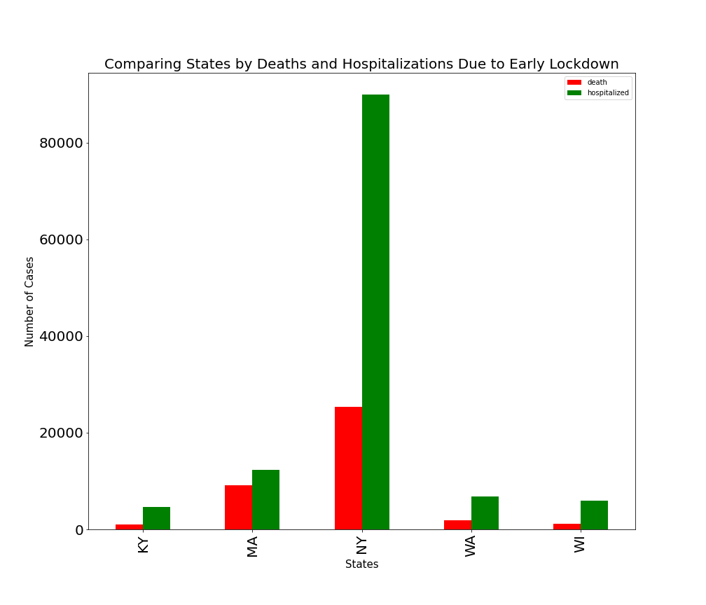
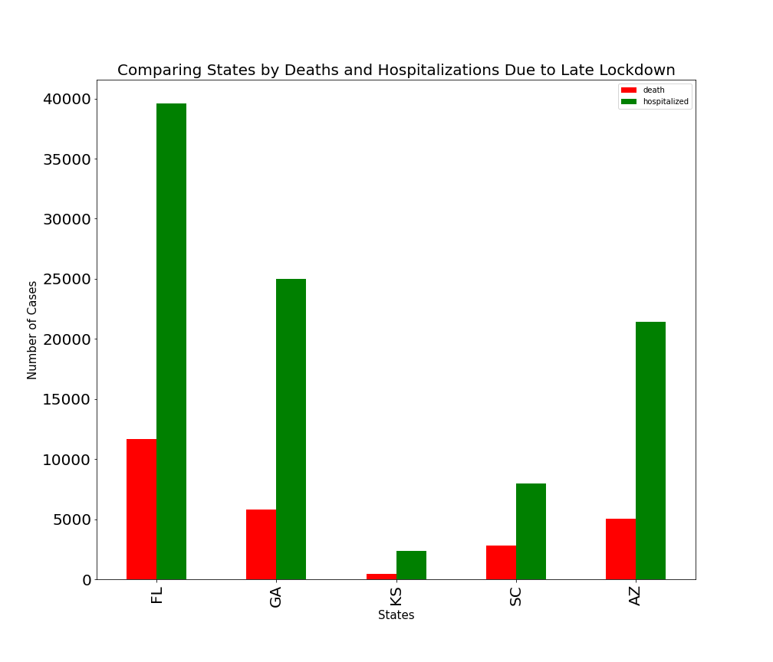
Key Findings
States with later lockdowns generally saw a higher increase of deaths and hospitalizations.
These states also typically had shorter periods of lockdown which increased the number of cases, hospitalizations and deaths.

Slide 9
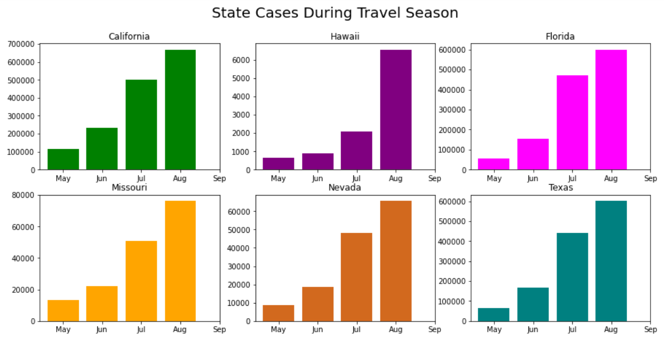
Key Findings
Cases saw a sharp rise at the start of summer due to increased travel to tourism hotspots.
Cases rose regardless of lockdown orders or state-wide mask mandates.

Slide 10
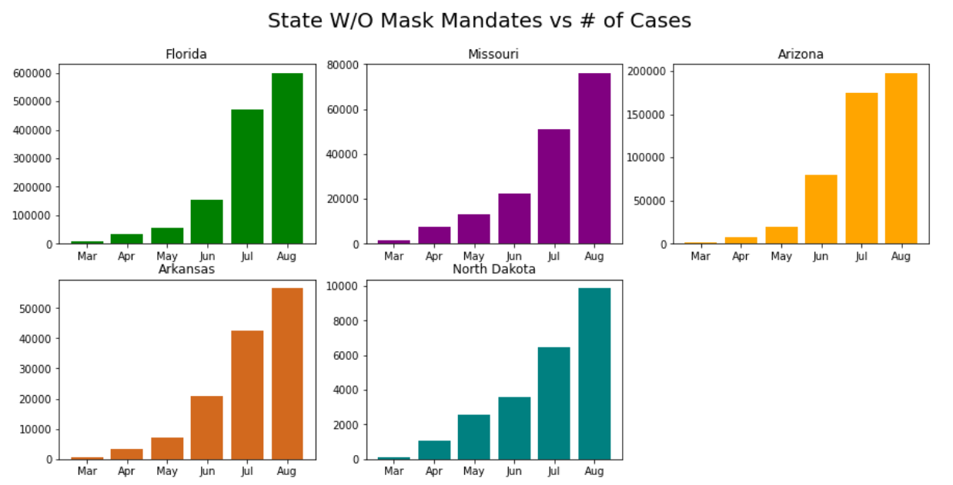
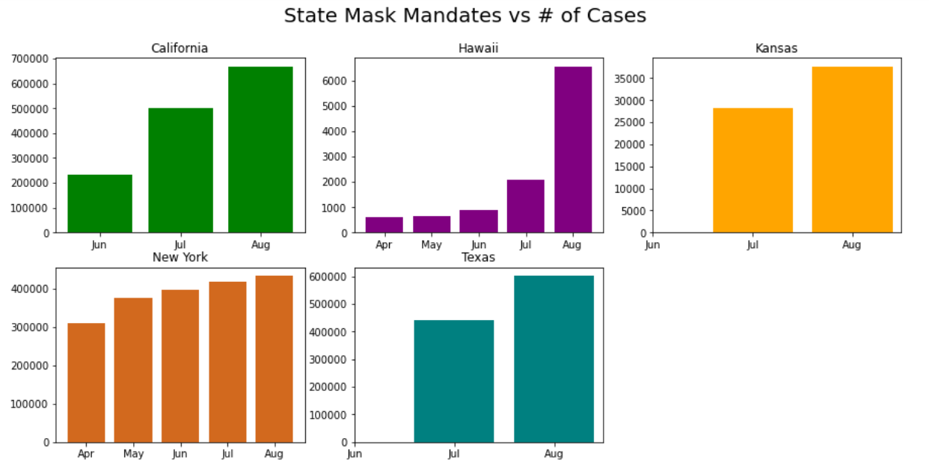
Key Findings
States without mask mandates in place saw a significantly faster rise in cases compared to most states with mandates.
The sharpest increase in cases occurred at the start of the summer months when tourism generally picks up.

Slide 11
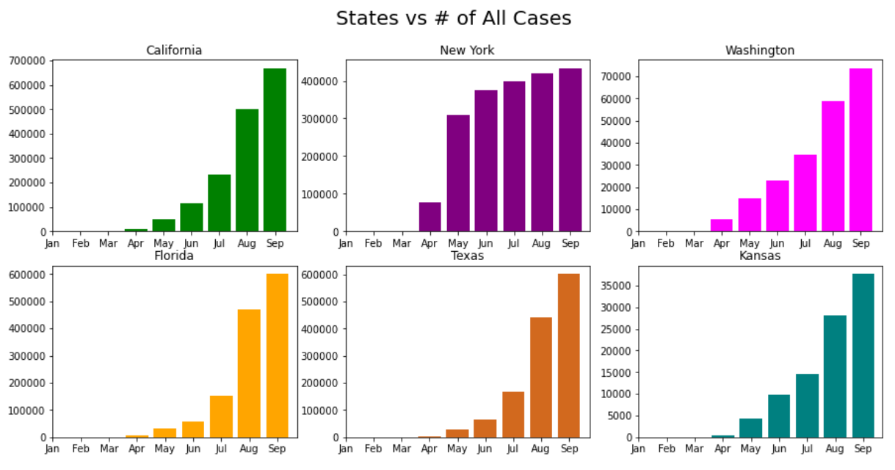
Conclusions
We feel the data supports our initial hypothesis. A nationally coordinated effort would have created a standardized guideline on how to safely reopen states and mandated mask measures to contain the spread of the virus.
At a minimum states should have been directed to follow CDC guidelines for state closures and reopening’s to help mitigate infections.

Slide 12
Postmortem
States were chosen to target all areas of the United States with varying levels of population density in order to show a truer representation of virus outbreak. Only looking at states with highly populated cities could skew the data set in a negative light.
Mask mandates, while proven effective, are only good if most or all residents comply. Because it has become a politicized issue, many individuals were slow to adopt the policy.
Deaths and hospitalization numbers may not be entirely accurate because there was not a standardized way of reporting COVID as COD early in the pandemic.
Not all states were able to be analyzed for this information because not all states report hospitalization numbers (i.e., California)

Slide 13
Questions?

